Slide 1


storytelling.
@humbleventures
#StartHumble
start@humble.vc

Slide 2

What is a Story?
Webster’s definition: an account of imaginary or real people and events told for entertainment.
Our Definition: What you can say to compel others to care intensely about otherwise mundane things and has the power to affect change.
Fundamental Elements: Audience + Shared Value + Narrative = Storytelling
@humbleventures
#StartHumble

Slide 3
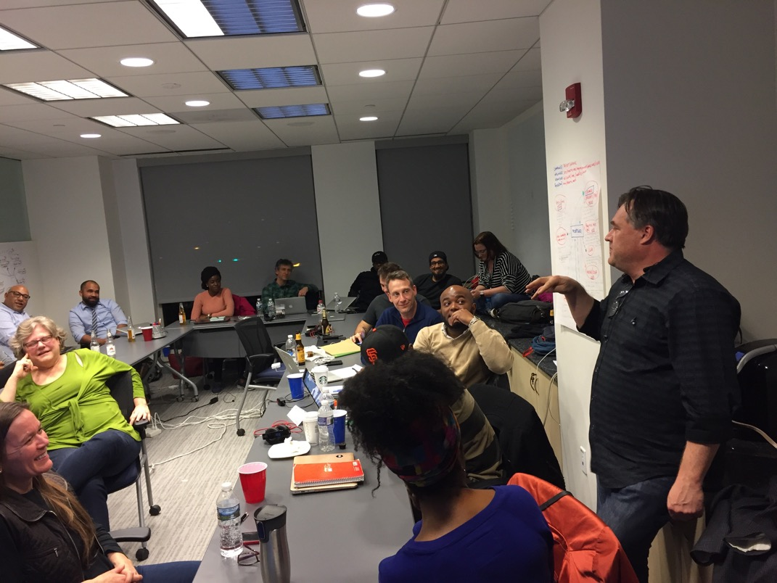
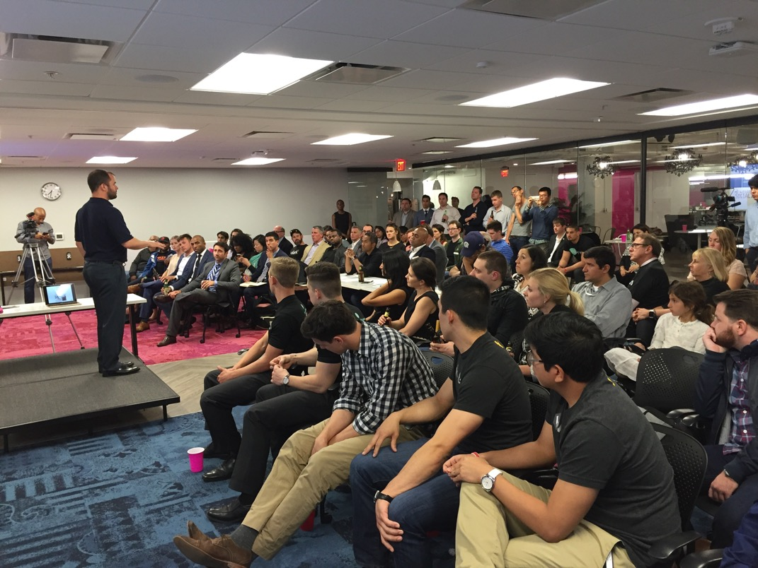
How is storytelling different than pitching?
With
At
@humbleventures
#StartHumble

Slide 4

@humbleventures
#StartHumble
Notes:
Avoid falling flat when Technical Difficulties arise…

Slide 5







We Have More Ways Than Ever to Tell Stories Today
@humbleventures
#StartHumble

Slide 6
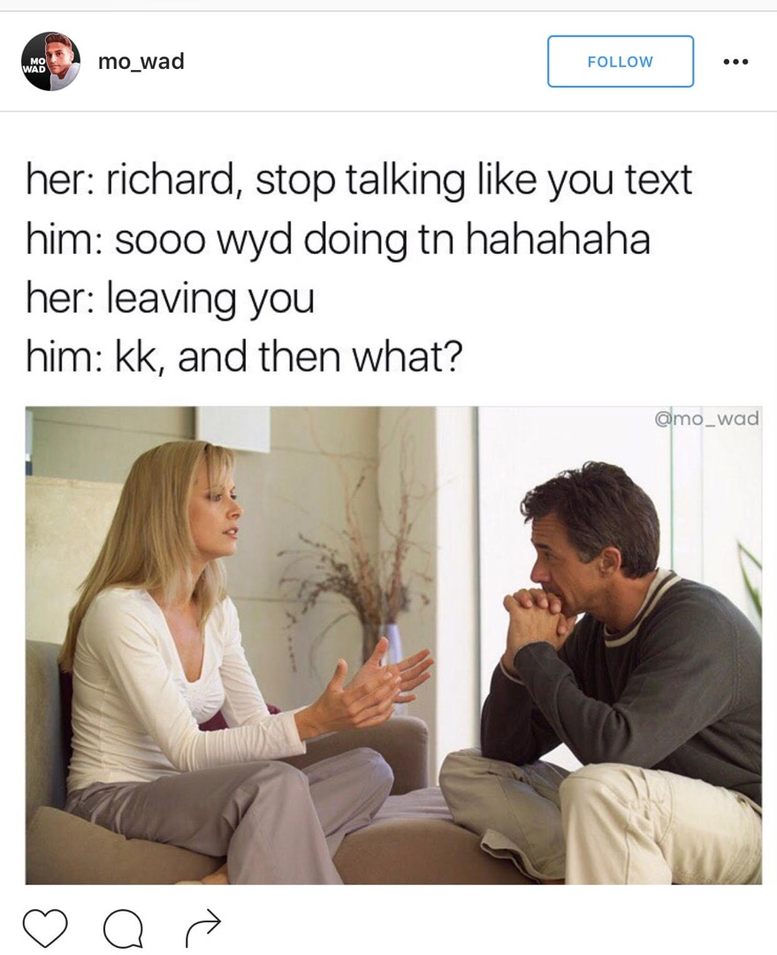
…Lots of People Get It Wrong.
@humbleventures
#StartHumble
Notes:
You are not a reporter (i.e. ”simply transcribing existing thoughts into words as accurately as possible).
You are not your resume.
You are not your list of product features.

Slide 7


How do you build a compelling narrative?
What are the core values you’re trying
to convey?
How do those relate to an audience?
Who are the “right” audiences?
What do you do when you have multiple audiences?
Make No Mistake… Telling Your Story is One of the Hardest Things to Do!
@humbleventures
#StartHumble

Slide 8
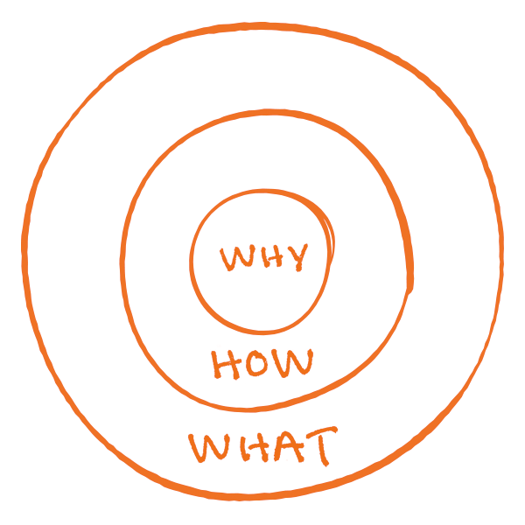
Why = The Purpose
What is your cause? What do you believe?
Apple: We believe in challenging the status quo
and doing this differently
How = The Process
Specific actions taken to realize the Why.
Apple: Our products are beautifully designed and easy to use
What = The Result
What do you do? The result of the Why. Proof.
Apple: We just happen to make computers
Created by Simon Sinek
@humbleventures
#StartHumble
Notes:
https://www.youtube.com/watch?v=qp0HIF3SfI4

Slide 9

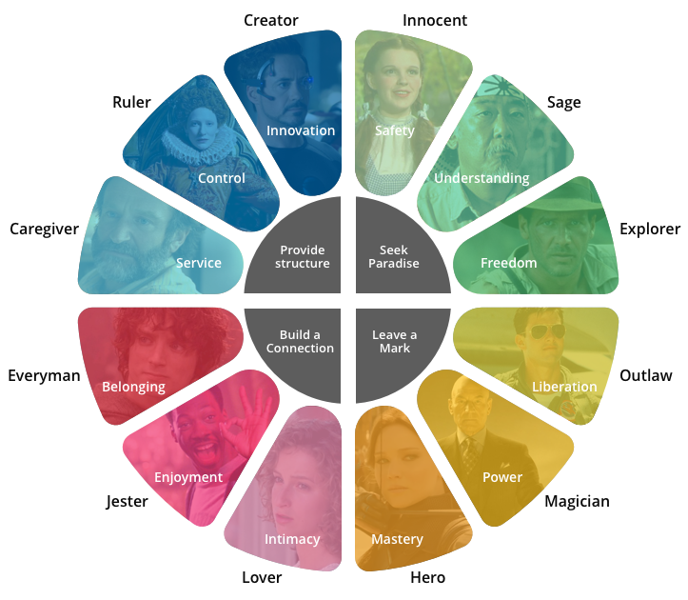




@humbleventures
#StartHumble

Slide 10
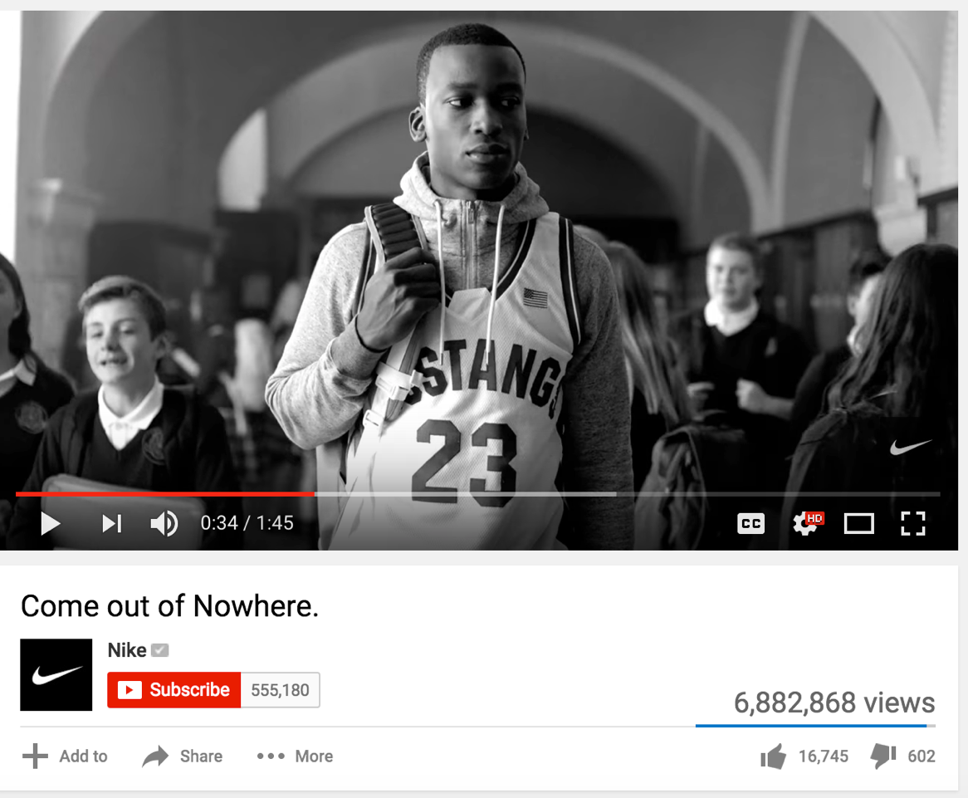
Why does your Story Matter?
How you tell your story & present your brand in always-crowded markets will be a differentiator that leads to engagement, referrals, and closures.
@humbleventures
#StartHumble
Notes:
https://www.youtube.com/watch?v=dOZxIpy6Gm4
Referral? Engagement? Closure?
Differentiation
Nike vs.

Slide 11
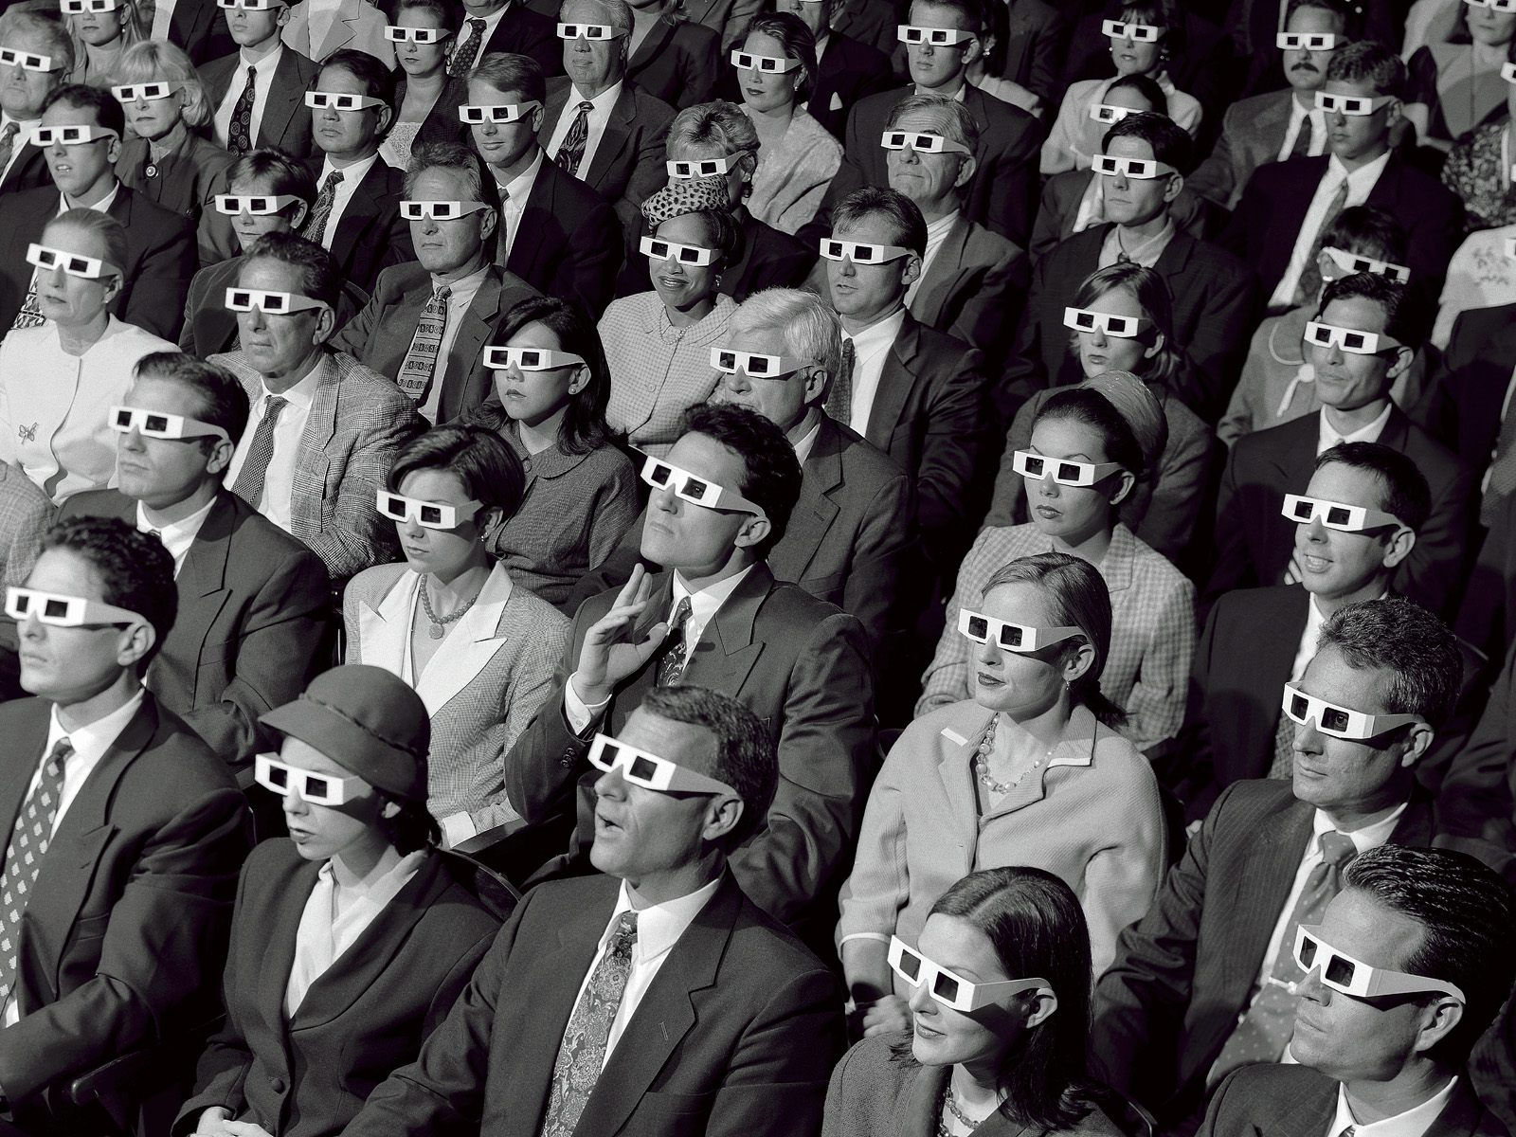
@humbleventures
#StartHumble
Notes:
Who Is Your Captive Audience? Insert Exercise

Slide 12
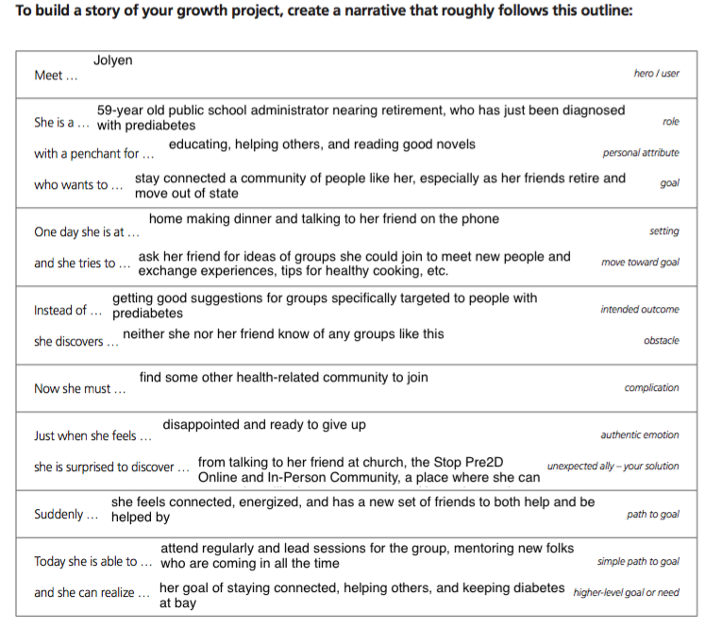
Created by Peer Insight
@humbleventures
#StartHumble

Slide 13

What if you have more than one audience?
@humbleventures
#StartHumble
Notes:
Where are you telling your story? Where are people listening? Insert Exercise

Slide 14
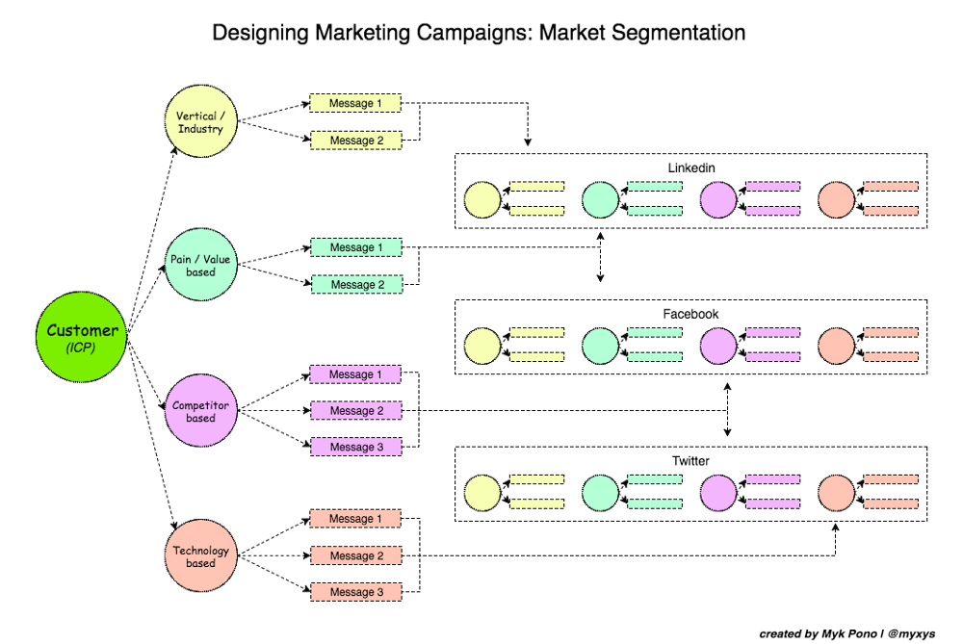
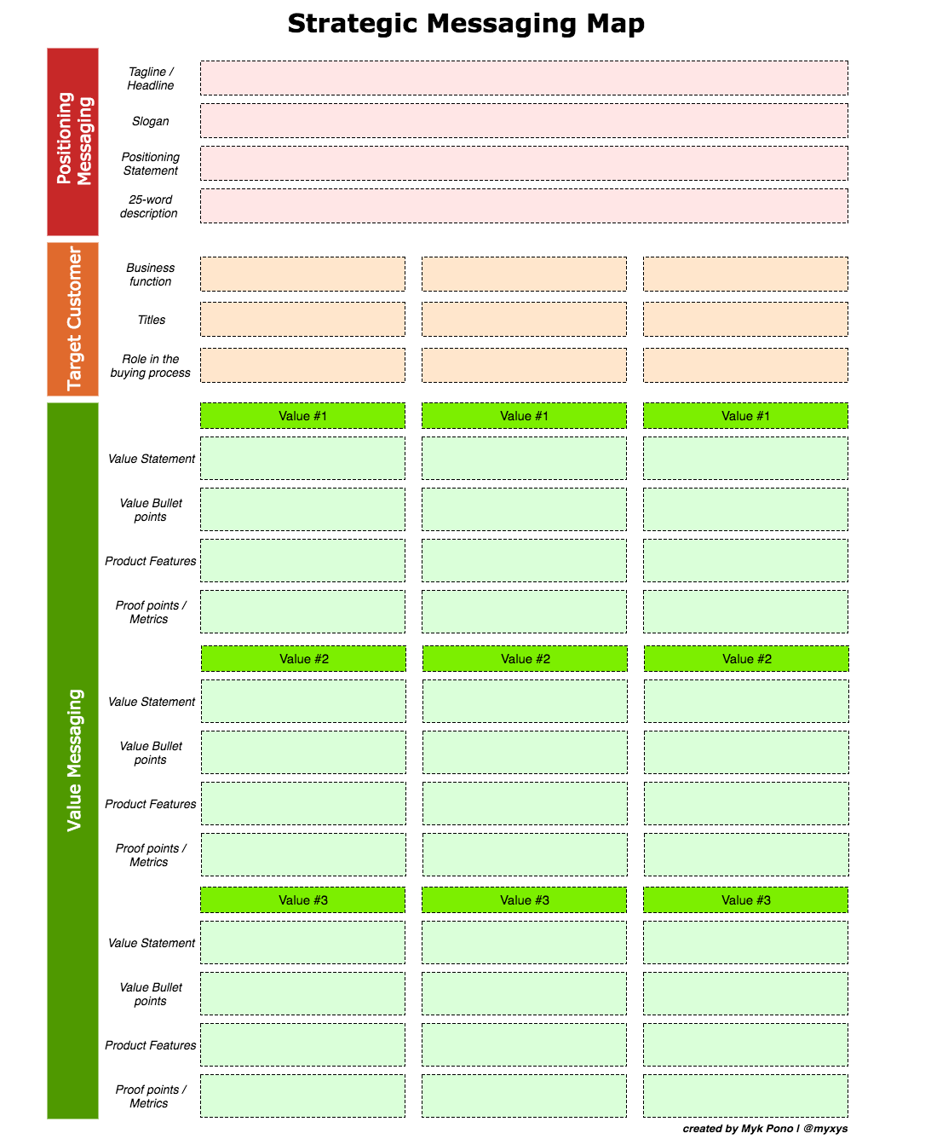
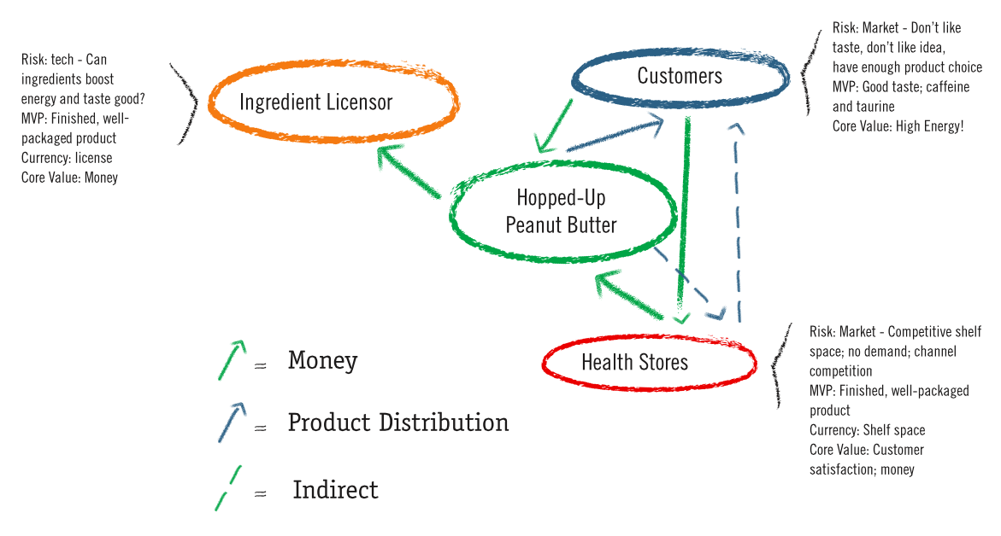
Created by Brant Cooper & Patrick Vlaskovits
@humbleventures
#StartHumble

Slide 15
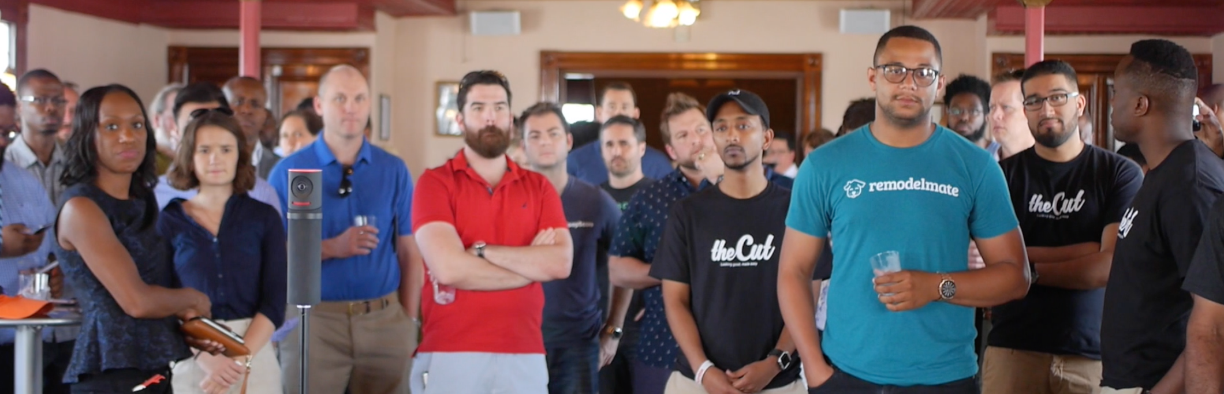
Questions?
Thank You!
@humbleventures
#StartHumble
start@humble.vc

